Slide 1


Slide 2
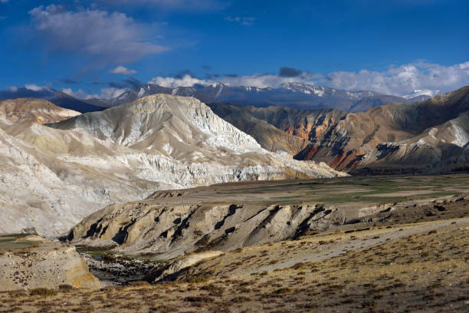
1
Which is the largest plateau in the world ?
Answer :Tibetan Plateau

Slide 3
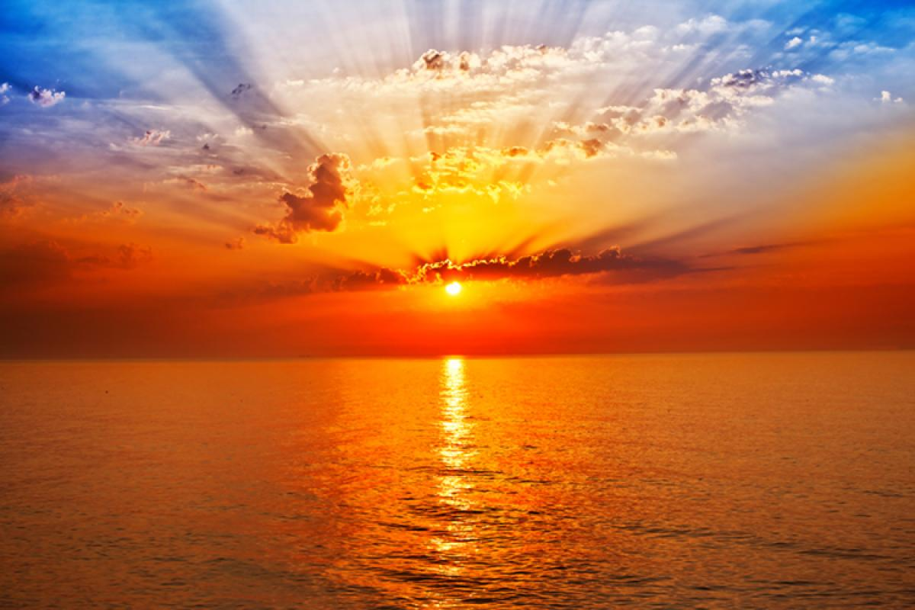
2
Which country is called the land of rising sun ?
Answer : Japan

Slide 4
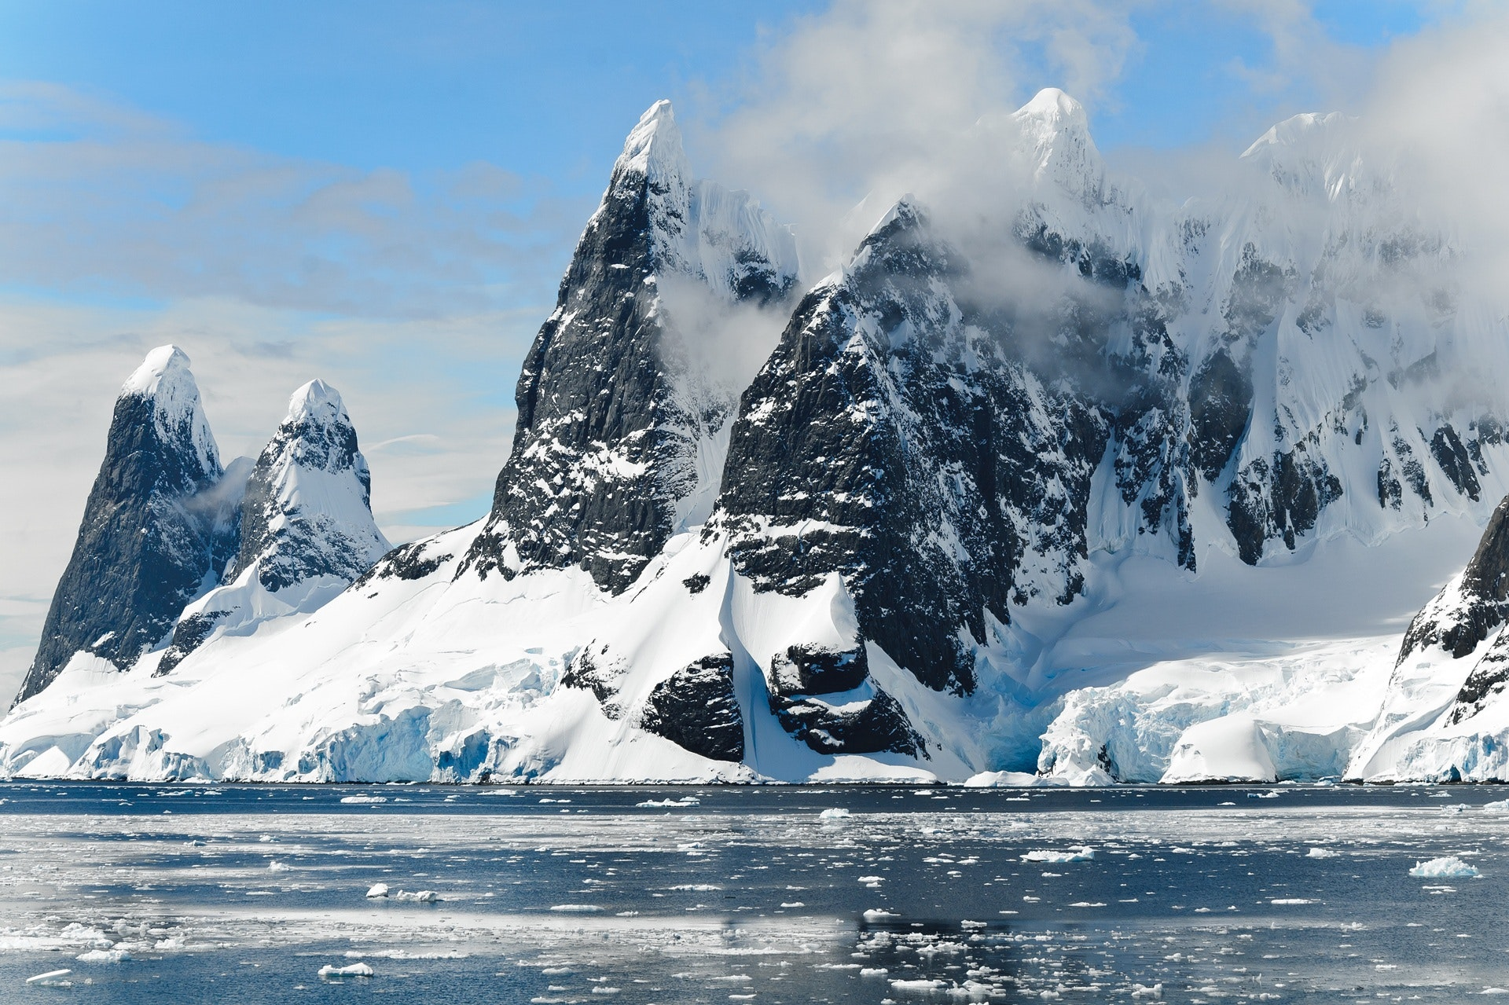
3
Which is the coldest location in the earth ?
Answer : Antarctica

Slide 5
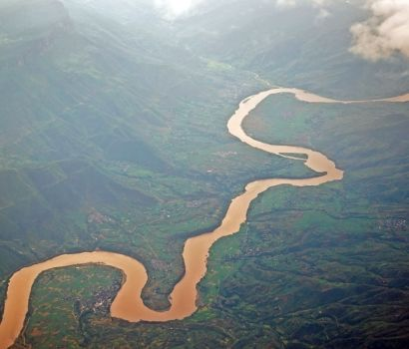
4
Which is the longest river on the earth ?
Answer : Nile

Slide 6


